Slide 1
Pointers
Pointers are variables that store the address of other variables.
The pointer variable might be belonging to any of the data type such as int, float, char, double, short etc.
Normal variable stores the value whereas pointer variable stores the address of the variable.
If you have a variable var in your program, &var will give you its address in the memory.
Pointer Syntax : data_type *var_name; Example : int *p; char *p;
Where, * is used to denote that “p” is pointer variable and not a normal variable.

Slide 2
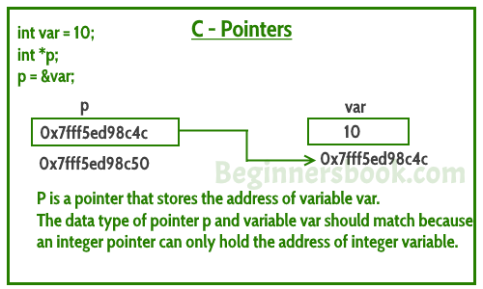
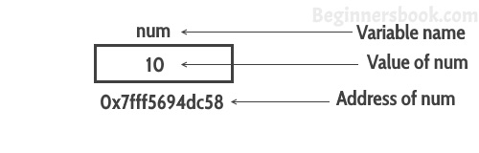

Slide 3
a=5
205
Int a;
Int *p;
P= &a;
P=205
604

Slide 4
b=8
209
a=5
205
Int a;
Int *p;
Int b;
P=&b;
P=209
604

Slide 5
Assigning addresses to Pointers
a=5
Int a=5;
Int *p;
we give the address to pointer as p=&a; Here, 5 is assigned to the a variable. And, the address of a is assigned to the p pointer.
If we want to print p cout<<p; //205 cout<<&a; //205 cout<<&p; //604 cout<<*p; //5 Derefrencing
205
P=205
604

Slide 6
Assigning addresses to Pointers
a=8
Int a=5;
Int *p;
we give the address to pointer as p=&a; Here, 5 is assigned to the a variable. And, the address of a is assigned to the p pointer.
If we want to print p cout<<p; //205 cout<<&a; //205 cout<<&p; //604 cout<<*p; //5 Derefrencing *p=8
cout<<*p; //8
205
P=205
604

Slide 7
Some Important points
Always C pointer is initialized to null, i.e. int *p = null.
The value of null pointer is 0.
& symbol is used to get the address of the variable.
* symbol is used to get the value of the variable that the pointer is pointing to.
If a pointer in C is assigned to NULL, it means it is pointing to nothing.
Pointer addition, multiplication, division are not allowed. You have to deference it first then you can Add, divide and multiply etc.
int *ip; /* pointer to an integer */
double *dp; /* pointer to a double */
float *fp; /* pointer to a float */
char *ch /* pointer to a character */
The actual data type of the value of all pointers, whether integer, float, character, or otherwise, is the same, a long hexadecimal number that represents a memory address. The only difference between pointers of different data types is the data type of the variable or constant that the pointer points to.

Slide 8
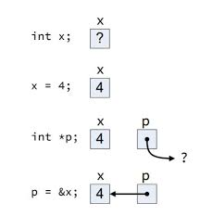

Slide 9
Representation of integer
Suppose we take an integer int a=1025; 1025 is representing as 32 bits because integer is of 4 bytes and every bytes contains 8 bits. So 1025 is representing the following way.
00000000
00000000
00000100
00000001
204
203
202
201

Slide 10
Void pointer
Void *p0;
P0=p1;
We can’t dereference it like we do in printing , and we can’t do this p0+1 We will discuss about this later.

Slide 11
Common mistakes
int c, *pc;
Pc=&c;
// pc is address but c is not
pc = c; // Error
// &c is address but *pc is not
*pc = &c; // Error
// both &c and pc are addresses
pc = &c;
// both c and *pc values
*pc = c;

Slide 12
Do not confuse on it
int main()
{
int c = 5;
int *p = &c;
cout<<*p; // 5
return 0;
}
Why didn't we get an error when using int *p = &c;?
It's because
int *p = &c;
is equivalent to
int *p:
p = &c;

Slide 13
Find Sum Find MAx

Slide 14
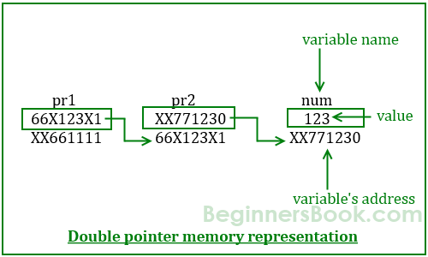
Pointers to Pointers
When a pointer holds the address of another pointer then such type of pointer is known as pointer-to-pointer or double pointer.
int **pr1; pr1=&pr2;

Slide 15
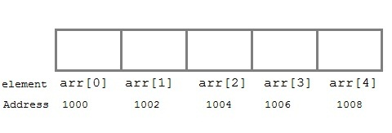
Pointers and arrays
Suppose we declare an array arr,
int arr[5] = { 1, 2, 3, 4, 5 };
Assuming that the base address ( i.e address of the first element of the array ) of arr is 1000 and each integer requires two bytes, the five elements will be stored as follows:

Slide 16
Here variable arr will give the base address, which is a constant pointer pointing to the first element of the array, arr[0]. Hence arr contains the address of arr[0] i.e 1000. In short, arr has two purpose - it is the name of the array and it acts as a pointer pointing towards the first element in the array.
arr is equal to &arr[0] by default
We can also declare a pointer of type int to point to the array arr.
int *p;
p = arr;
// or,
p = &arr[0]; //both the statements are equivalent.
Similarly if you print *(arr+1) it is same as arr[1]
Now we can access every element of the array arr using p++ to move from one element to another.

Slide 17
int main()
{
int i;
int a[5] = {1, 2, 3, 4, 5};
int *p = a; // same as int*p = &a[0]
for (i = 0; i < 5; i++)
{
cout<<*p;
p++;
}
return 0;
}
In the above program, the pointer *p will print all the values stored in the array one by one. We can also use the Base address (a in above case) to act as a pointer and print all the values.

Slide 18
Array to Function as parameters
Arrays always passed as referenced parameter.
It never get copied completely.
We cant increment and decrement like pointer

Slide 19
Why we use Pointers
Pointers are used to store and manage the addresses of dynamically allocated blocks of memory. Such blocks are used to store data objects or arrays of objects.
Most structured and object-oriented languages provide an area of memory, called the heap or free store, from which objects are dynamically allocated.
you can even use ++ and -- with a pointer, but not with an array name because this is a constant pointer and cannot be changed. So to summarise: An array's name is a constant pointer to the first element in the array that is a==&a[0] and *a==a[0].

Slide 20
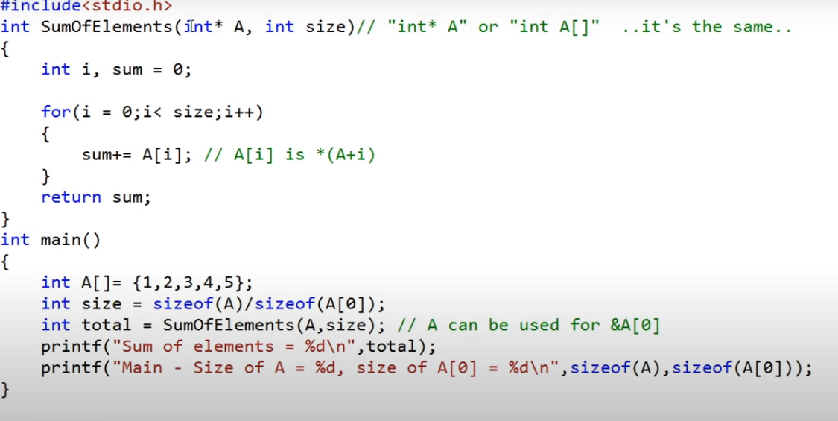
Array to Function as parameters
Notes:
Sum=sum+A[i]

Slide 21
int* fun()
{
int A = 10;
return (&A);
}
// Driver Code
int main()
{
// Declare a pointer
int* p;
// Function call
p = fun();
cout<<p;
cout<<*p;
return 0;
}
ERRor

Slide 22
int* fun()
{
// Declare a static integer
static int A = 10;
return (&A);
}
// Driver Code
int main()
{
// Declare a pointer
int* p;
// Function call
p = fun();
// Print Address
cout<<p;
// Print value at the above address
cout<<*p;
return 0;
}

Slide 23
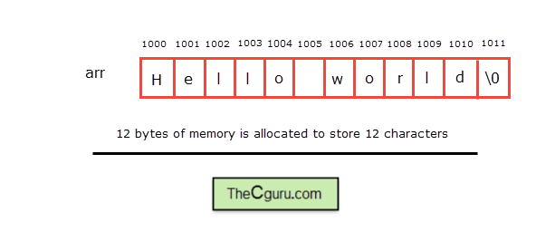
Character Arrays and pointers
Character arrays should be large enough to store a string.

Slide 24
Functions in string.h
String functions | Description
strcat ( ) | Concatenates str2 at the end of str1
strncat ( ) | Appends a portion of string to another
strcpy ( ) | Copies str2 into str1
strncpy ( ) | Copies given number of characters of one string to another
strlen ( ) | Gives the length of str1
strcmp ( ) | Returns 0 if str1 is same as str2. Returns <0 if strl < str2. Returns >0 if str1 > str2
strcmpi ( ) | Same as strcmp() function. But, this function negotiates case. “A” and “a” are treated as same.
strchr ( ) | Returns pointer to first occurrence of char in str1
strrchr ( ) | last occurrence of given character in a string is found
strstr ( ) | Returns pointer to first occurrence of str2 in str1
strrstr ( ) | Returns pointer to last occurrence of str2 in str1
strdup ( ) | Duplicates the string
strlwr ( ) | Converts string to lowercase
strupr ( ) | Converts string to uppercase
strrev ( ) | Reverses the given string
strset ( ) | Sets all character in a string to given character
strnset ( ) | It sets the portion of characters in a string to given character
strtok ( ) | Tokenizing given string using delimiter
https://www.tutorialspoint.com/c_standard_library/string_h.htm

Slide 25
Character Arrays and pointers
Like we can handle pointers with array, similarly we can use character type pointers for character arrays.
We can also print the array as ptr[2]; l
Ptr[0] = A; //Aello
*ptr=A;
Ptr++…
char arr[] = "Hello"; // array version char *ptr ;// pointer version ptr=arr ;

Slide 26
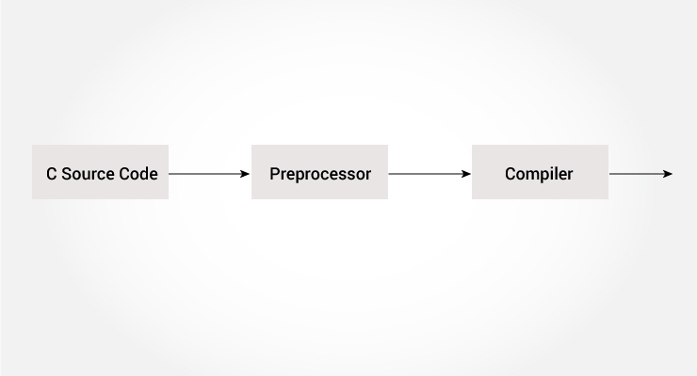
Macros
With macro(#define): macro will be replaced with its value in source code compile time only, so compiler does not need to look into memory even single time, it compiles code directly with constant value. So it is better to use macro than constant variable

Slide 27
Dynamic Memory
Sometimes the size of the array you declared may be insufficient. To solve this issue, you can allocate memory manually during run-time. This is known as dynamic memory allocation in C programming.

Slide 28
Heap
Many times, you are not aware in advance how much memory you will need to store particular information in a defined variable and the size of required memory can be determined at run time.
You can allocate memory at run time within the heap for the variable of a given type using a special operator in C++ which returns the address of the space allocated. This operator is called new operator.
If you are not in need of dynamically allocated memory anymore, you can use delete operator, which de-allocates memory that was previously allocated by new operator.

Slide 29
Heap
double* pvalue = NULL; // Pointer initialized with null
pvalue = new double;
double* pvalue = NULL;
if( !(pvalue = new double )) {
cout << "Error: out of memory." <<endl;
exit(1);
}

Slide 30
Heap deletion
At any point, when you feel a variable that has been dynamically allocated is not anymore required, you can free up the memory that it occupies in the free store with the ‘delete’ operator as follows −
delete pvalue;

Slide 31
Dynamic Memory Allocation for Arrays
char* pvalue = NULL; // Pointer initialized with null
pvalue = new char[20];
delete [] pvalue;
double** pvalue = NULL; // Pointer initialized with null
pvalue = new double [3][4];
delete [] pvalue;

Slide 32
Dynamic Memory Allocation for Arrays
UNION and INTERSECTION

Slide 33
MEMORY LEAK & DANGLING POINTERS
A dangling pointer points to memory that has already been freed. The storage is no longer allocated. Trying to access it might cause a Segmentation fault.
int *c = new int();
Delete c;
*c = 3; //writing to freed location!
A memory leak is memory which hasn't been freed, there is no way to access (or free it) now, as there are no ways to get to it anymore. (E.g. a pointer which was the only reference to a memory location dynamically allocated (and not freed) which points somewhere else now.)
void func(){
char *ch = new int(10);
}
//ch not valid outside, no way to access malloc-ed memory

Slide 34
Character Arrays
#include <iostream>
const max_len = 256;
int main()
{
using namespace std;
cout << "Please enter string: ";
char* str = new char[max_len + 1];
for (int i = 0; i < max_len; i++)
{
cin >> str[i];
if (str[i] == '\n')
{
str[i] = '\0';
break;
}
}
cout << "Entered string is:" << str << endl;
delete [] str;
return 0;

Slide 35
Unusual behaviour with character pointers
using namespace std; // Driver Code int main() { // Integer array int a[] = { 1, 2, 3 }; // Character array char ch[] = "abc"; // Print the value of a and b cout << a << endl; cout << ch << endl; return 0; }
Output:
0x7ffc623e56c0
abc

Slide 36
Unusual behaviour with character pointers
#include <iostream>
using namespace std;
// Driver Code
int main()
{
// Character array b
char b[] = "abc";
// Pointer to character array
char* c = &b[0];
// Print the value of c
cout << c << endl;
}
Output:
abc
Explanation:
In this example as well, the character type pointer c is storing the base address of the char array b[] and hence when used with cout, it starts printing each and every character from that base address till it encounters a NULL character.

Slide 37
Dynamic character array
#include <iostream>
#include <cstring>
using namespace std;
int main()
{
char *s1=new char[50];
char *s2=new char[50];
cout << "Enter string s1: ";
cin.getline(s1, 50);
cout << "Enter string s2: ";
cin.getline(s2, 50);
strcat(s1, s2);
cout << "s1 = " << s1 << endl;
cout << "s2 = " << s2;
}

Slide 38
Void Pointer
A void pointer is a pointer that has no associated data type with it. A void pointer can hold address of any type and can be typecasted to any type.
int a = 10;
char b = 'x';
void *p = &a; // void pointer holds address of int 'a'
p = &b; // void pointer holds address of char 'b'

Slide 39
Facts about Void Pointer
void pointers cannot be dereferenced. For example the following program doesn’t compile.
#include<iostream>
using namespace std;
int main()
{
int a = 10;
void *ptr = &a;
cout<< *ptr;
return 0;
}
The following program compiles and runs fine.
#include<iostream>
using namespace std;
int main()
{
int a = 10;
void *ptr = &a;
cout<< *(int *)ptr;
return 0;
}

Slide 40
Pointers to 2D array
In a two dimensional array, we can access each element by using two subscripts, where first subscript represents the row number and second subscript represents the column number.
The elements of 2-D array can be accessed with the help of pointer notation also. Suppose arr is a 2-D array, we can access any element arr[i][j] of the array using the pointer expression *(*(arr + i) + j). Now we’ll see how this expression can be derived.

Slide 41
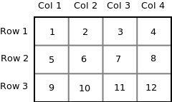
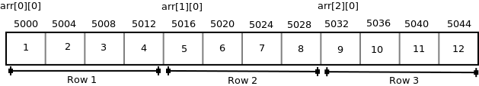
Pointers to 2D array
int arr[3][4] = { {1, 2, 3, 4}, {5, 6, 7, 8}, {9, 10, 11, 12} };
Since memory in a computer is organized linearly it is not possible to store the 2-D array in rows and columns. The concept of rows and columns is only theoretical, actually, a 2-D array is stored in row-major order i.e rows are placed next to each other. The following figure shows how the above 2-D array will be stored in memory.

Slide 42
Pointers to 2D array
Each row can be considered as a 1-D array, so a two-dimensional array can be considered as a collection of one-dimensional arrays that are placed one after another.
So here arr is an array of 3 elements where each element is a 1-D array of 4 integers.

Slide 43
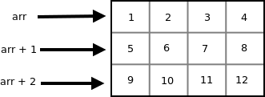

Pointers to 2D array
Since arr is a ‘pointer to an array of 4 integers’, according to pointer arithmetic the expression arr + 1 will represent the address 5016 and expression arr + 2 will represent address 5032.
So we can say that arr points to the 0th 1-D array, arr + 1 points to the 1st 1-D array and arr + 2 points to the 2nd 1-D array.

Slide 44
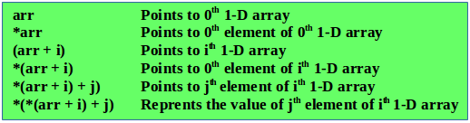
To access an individual element of our 2-D array, we should be able to access any jth element of ith 1-D array.
Since the base type of *(arr + i) is int and it contains the address of 0th element of ith 1-D array, we can get the addresses of subsequent elements in the ith 1-D array by adding integer values to *(arr + i).
For example *(arr + i) + 1 will represent the address of 1st element of 1st element of ith 1-D array and *(arr+i)+2 will represent the address of 2nd element of ith 1-D array.
Similarly *(arr + i) + j will represent the address of jth element of ith 1-D array. On dereferencing this expression we can get the jth element of the ith 1-D array.

Slide 45
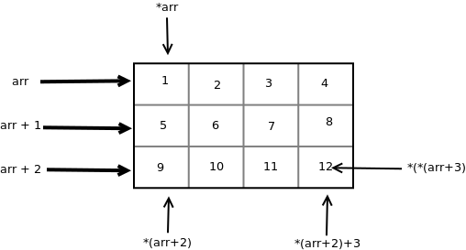
For example *(arr + i) + 1 will represent the address of 1st element of 1st element of ith 1-D array and *(arr+i)+2 will represent the address of 2nd element of ith 1-D array.
Similarly *(arr + i) + j will represent the address of jth element of ith 1-D array. On dereferencing this expression we can get the jth element of the ith 1-D array.

Slide 46
Address of 0th array = 0x7ffe50edd580 0x7ffe50edd580
10 10 11 11 12 12 13 13
Address of 1th array = 0x7ffe50edd590 0x7ffe50edd590
20 20 21 21 22 22 23 23
Address of 2th array = 0x7ffe50edd5a0 0x7ffe50edd5a0
30 30 31 31 32 32 33 33
int main()
{
int arr[3][4] = {
{ 10, 11, 12, 13 },
{ 20, 21, 22, 23 },
{ 30, 31, 32, 33 }
};
int i, j;
for (i = 0; i < 3; i++)
{
cout<< i, arr[i], *(arr + i);
for (j = 0; j < 4; j++)
cout<<arr[i][j]<< *(*(arr + i) + j);
cout<<\n";
}
return 0;

Slide 47
using namespace std;
// Driver Code
int main()
{
// Dimensions of the array
int m = 3, n = 4, c = 0;
// Declare memory block of size M
int** a = new int*[m];
for (int i = 0; i < m; i++) {
// Declare a memory block
// of size n
a[i] = new int[n];
}
// Traverse the 2D array
for (int i = 0; i < m; i++) {
for (int j = 0; j < n; j++) {
// Assign values to the
// memory blocks created
a[i][j] = ++c;
}
}
// Traverse the 2D array
for (int i = 0; i < m; i++) {
for (int j = 0; j < n; j++) {
// Print the values of
// memory blocks created
cout << a[i][j] << " ";
}
cout << endl;
}
//Delete the array created
for(int i=0;i<m;i++) //To delete the inner arrays
delete [] a[i];
delete [] a; //To delete the outer array
//which contained the pointers
//of all the inner arrays
return 0;
}

Slide 48
Accessing ctype string via pointer
int main() {
// string variable
char str[6] = "Hello";
// pointer variable
char *ptr = str;
// print the string
while(*ptr != '\0') {
cout<< *ptr;
// move the ptr pointer to the next memory location
ptr++;
}

Slide 49
Using pointer to store string
int main() {
// pointer variable to store string
char *strPtr = "Hello";
// temporary pointer variable
char *t = strPtr;
// print the string
while(*t != '\0') {
cout<< *t;
// move the t pointer to the next memory location
t++;
}
}

Slide 50
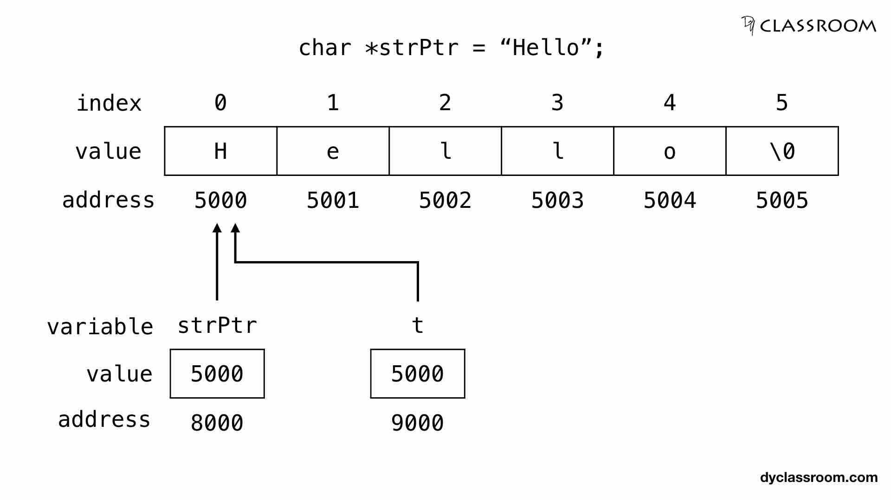

Slide 51
Array of strings
int main() {
char city[4][12] = {
"Chennai",
"Kolkata",
"Mumbai",
"New Delhi"
};
}

Slide 52
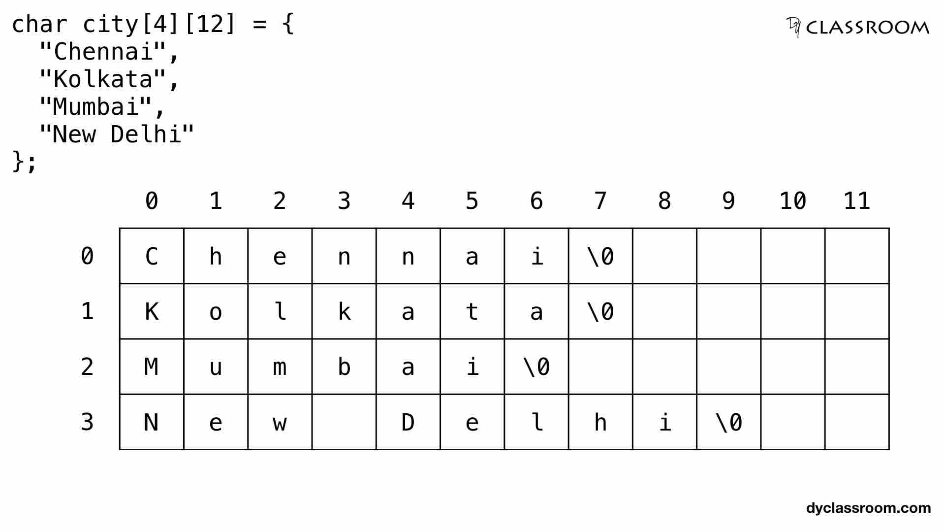

Slide 53
character array
int main() {
char *cityPtr[4] = {
"Chennai",
"Kolkata",
"Mumbai",
"New Delhi"
};
}

Slide 54
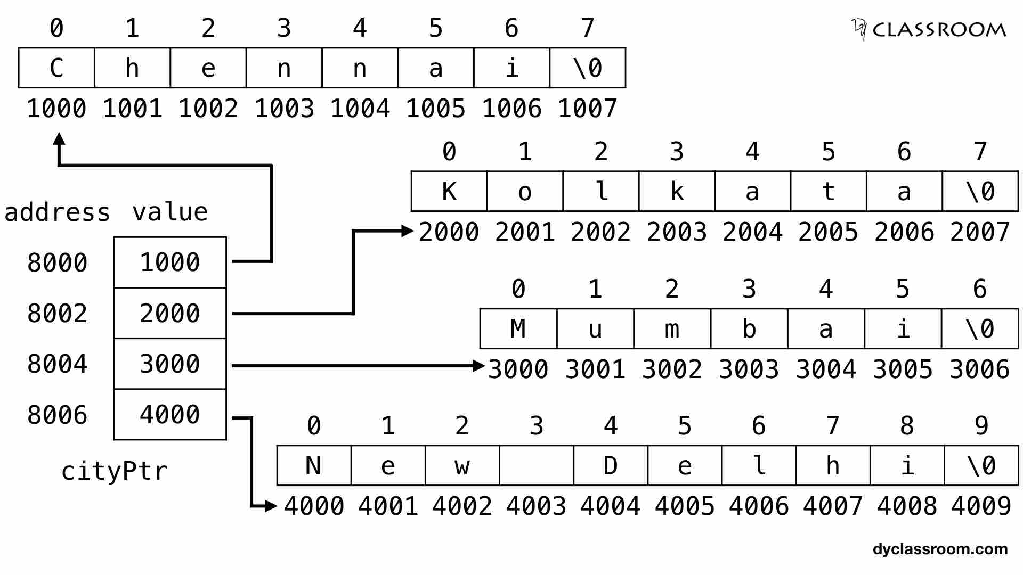

Slide 55
string array
int main()
{
const int MAX = 80; //max characters in string
char str[MAX]; //string variable str
Chapter 7
290
cout << “Enter a string: “;
cin >> str; //put string in str
//display string from str
cout << “You entered: “ << str << endl;
return 0;
}
The definition of the string variable str looks like (and is) the definition of an array of type char:
char str[MAX];

Slide 56
Arrays of Strings
#include <iostream>
using namespace std;
int main()
{
const int DAYS = 7; //number of strings in array
const int MAX = 10; //maximum size of each string
//array of strings
char star[DAYS][MAX] = { “Sunday”, “Monday”, “Tuesday”,
“Wednesday”, “Thursday”,
“Friday”, “Saturday” };
for(int j=0; j<DAYS; j++) //display every string
cout << star[j] << endl;
return 0;
}

Slide 57
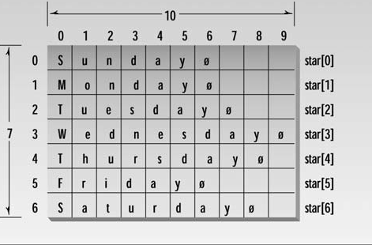
Arrays of Strings

